Slide 1
Sustainable Cities
Made by Dominic Karl and Christian Gruber

Slide 2
General Facts
Eco – City
Designed with consideration of environmental impact
Minimization of
Energy
Water
Food
waste
Output of heat
Air pollution
Water pollution

Slide 3
Characteristics of sustainable cities
Feed itself
Power itself
Composting used materials
Recycling or converting waste to energy

Slide 4
Practical achievement
Different agricultural systems
Reducing the distance from field to fork
Renewable energy sources
Wind turbines, solar panels
Reducing the need for air conditioning
Planting trees, increase in water features, green spaces
Public transport
Reducing car emissions

Slide 5
Practical achievement
Green roofs
Sustainable transport
Electric busses, hybrid driving system
Affordable
Zero energy building
Zero net energy consumption
Consumes renewable energy created on the site
Xeriscaping
Eliminates the need for supplemental water for plants

Slide 6
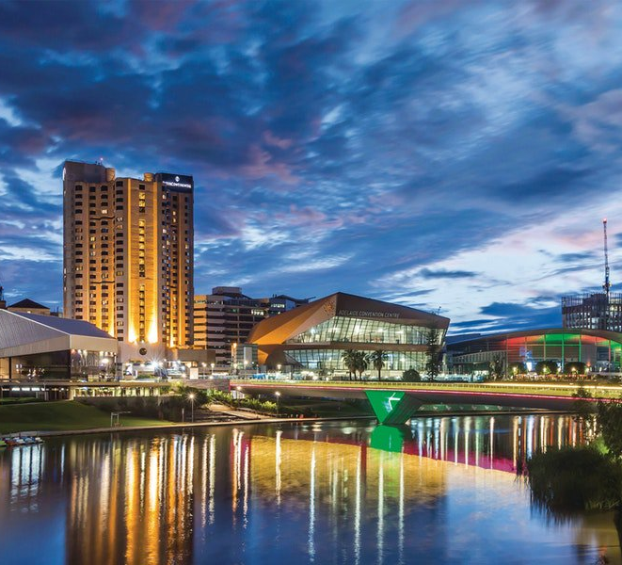
Sustainable city – Adelaide, Australia
Adelaide
Planted 3million native trees and shrubs(=Sträucher)
Uses wind power which makes up to 26% of the cities used electricity
Recycling rate of nearly 80%

Slide 7
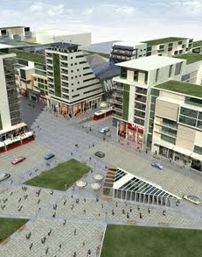
Sustainable city - Ireland
Ireland
Announced plans for “Clonburris” in 2007, which contained the highest international standards, high levels of energy efficiency, mandatory renewable energy for heating and electricity, use of recycled and sustainable building materials and a lot of other stuff

Slide 8
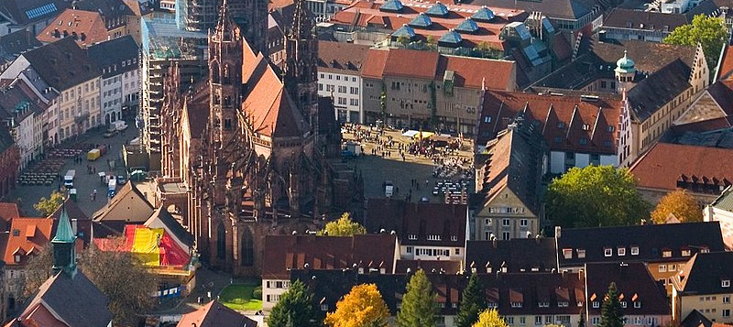
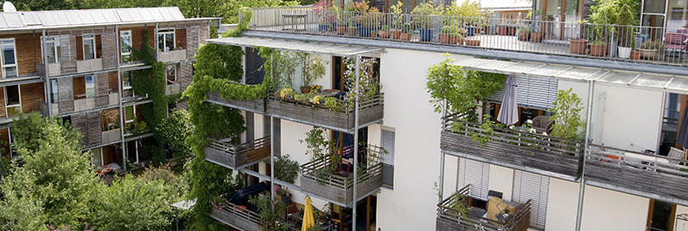
Sustainable city - Germany
Freiburg im Breisgau:
Known for its strong solar energy industry
Vauban, Freiburg:
Sustainable model district
All houses are built to a low energy consumption standard and is designed to be carfree
Rieselfeld, Freiburg
A district in which houses produce more energy than they consume

Slide 9
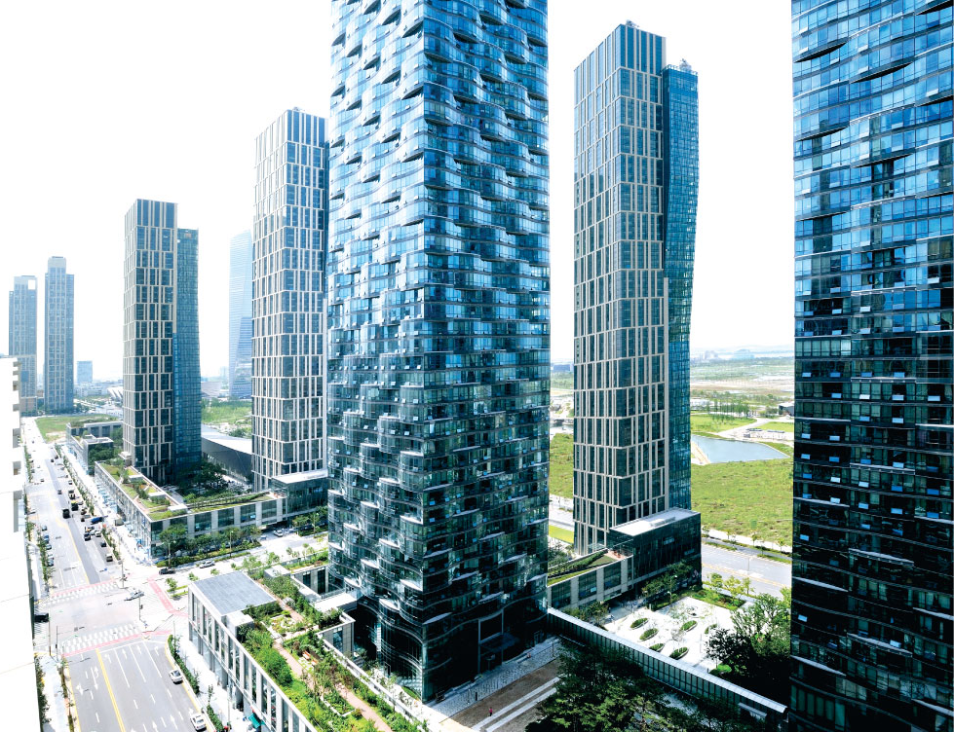
Sustainable City – Korea
Songdo IBD
Planned city in Incheon
Central park irrigated with seawater
Subway line
Bycicle lanes
Rainwater catchment systems
Pneumatic waste collection system
75% of waste will be recycled
Next planned sustainable city is

Slide 10
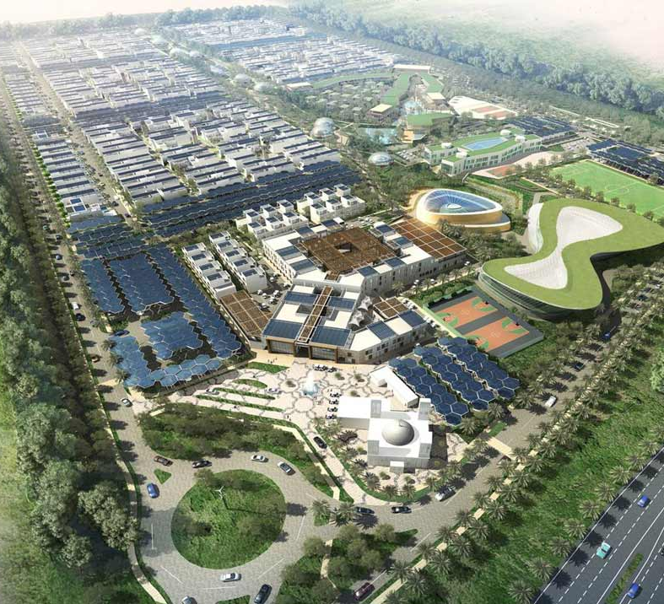
Sustainable City - Dubai
46 hectare property
500 townhouses and courtyard villas
11 natural biodome greenhouses
10 MW peak solar production
Waste water recycling
Parking areas are topped by solar shading featuring solar panels.

